Slide 1
Behavioral Design Patterns
.

Slide 2
Flow of presentation
What is design Pattern
Behavioral design pattern and its types
Observer Pattern
State Pattern
Chain of Responsibility Pattern
Command Pattern
Iterator Pattern
Strategy Pattern
Template Pattern
Mediator Pattern
Memento Pattern
Visitor Pattern

Slide 3
What's a design pattern?
Design patterns are solutions to general problems that software developers faced during software development.
These solutions were obtained by trial and error by numerous software developers over quite a substantial period of time.
Types of Design Pattern
Creational Design Pattern,
Structural Design Pattern
Behavioral Design Pattern

Slide 4
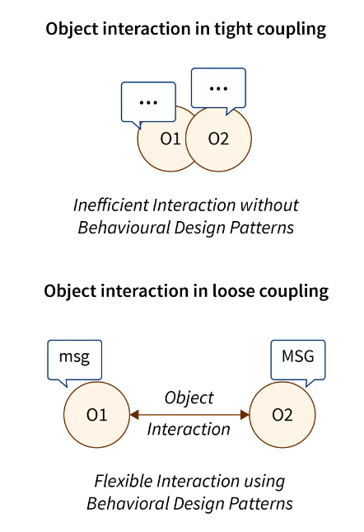
Behavioral Design Patterns
Behavioral design patterns are concerned with the interaction and responsibility of objects.
In these design patterns, the interaction between the objects should be in such a way that they can easily talk to each other and still should be loosely coupled.
That means the implementation and the client should be loosely coupled in order to avoid hard coding and dependencies.

Slide 5
Types of Behavioral Design Pattern
Observer Pattern
State Pattern
Chain of Responsibility Pattern
Command Pattern
Iterator Pattern
Strategy Pattern
Template Pattern
Mediator Pattern
Memento Pattern
Visitor Pattern
.

Slide 6
Observer Pattern
An observer pattern is a behavioral pattern that is used to monitor the state of multiple objects or classes. It acts as a notifier of change to multiple classes. Using the observer pattern, the change in the state of an object is reflected among other objects in the application.
When to use Observer Pattern
When modifications in the state of one object require a change in other objects.
When some objects must observe other objects only for a limited time or in specific cases.

Slide 7
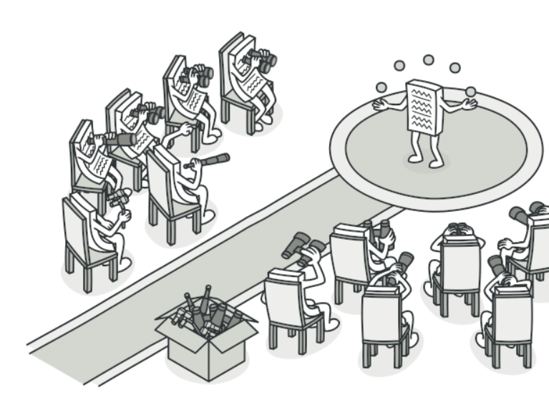
Observer Pattern

Slide 8
State Pattern
A state pattern is a behavioral design pattern that is used when a specific object needs to change its behaviour based on its internal state. It provides a way for an object to partially change its type at runtime. It appears as if the object changed its class at runtime.
When to use State Pattern
When we have an object that behaves differently depending on its current state.
When we wish to implement different class behaviours according to the current values of the class’s fields.

Slide 9
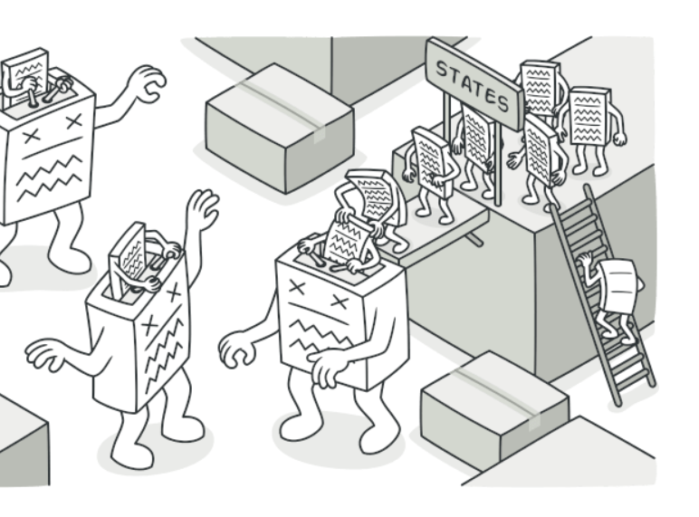
State Pattern
.

Slide 10
Chain of Responsibility Pattern
It is a behavioral design pattern that allows us to pass a request between a chain of objects. Each object in the chain contains its processing logic that performs some action and decides the next object from the chain to delegate the work. It is used in decoupling the sender from the receiver.
When to use Chain of Responsibility Pattern
When we wish to decouple the request's sender from its receiver.
When the request provided to the application can be handled by passing it to a series of objects.
When we need to enhance the flexibility of the duties assigned to objects.

Slide 11
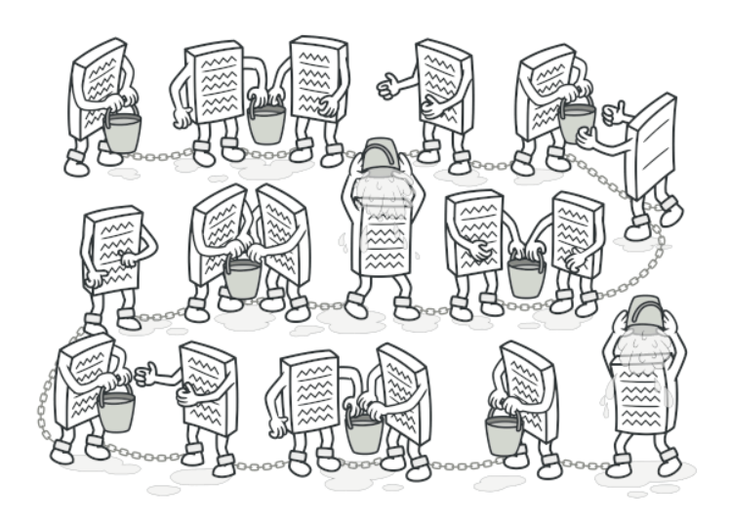
Chain of Responsibility Pattern

Slide 12
Command Pattern
It is a data-driven behavioral pattern that turns a request into a stand-alone object known as a command. It encapsulates all the information that is required to act i.e., it wraps the action and its required parameters together in an object. It is used to separate the object that invokes the operation from the object that operates.
When to use Command Pattern
When we need to attach operations with objects using which we can queue operations, schedule their execution, or execute them remotely.
When we wish to implement reversible operations like undo and redo operations. Since the command pattern allows us to create objects that represent the actions that are to be performed in the application, we can create a list of tasks performed (list of command objects) and can undo or redo the task just by searching and executing the undo method of the last command object from the task list.

Slide 13
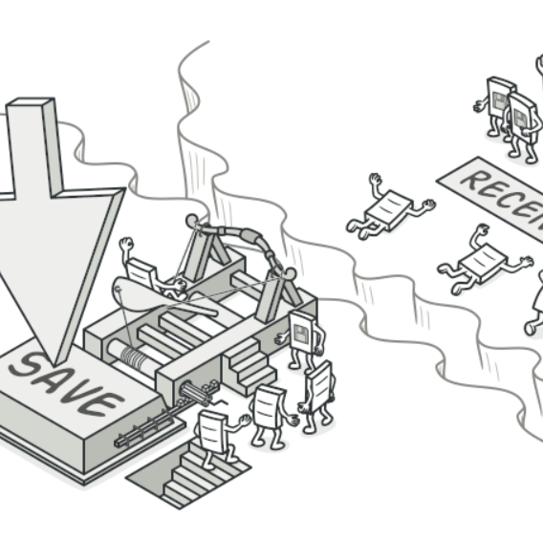
.
Command Pattern

Slide 14
Iterator Pattern
An iterator pattern is a type of behavioral pattern that is used to sequentially access the elements of a collection without exposing its underlying or internal representation.
When to use Iterator Pattern
When we wish to provide a way to access and traverse the elements of a collection without revealing the internal data structures to the clients.
When we want the application to traverse different data structures.

Slide 15
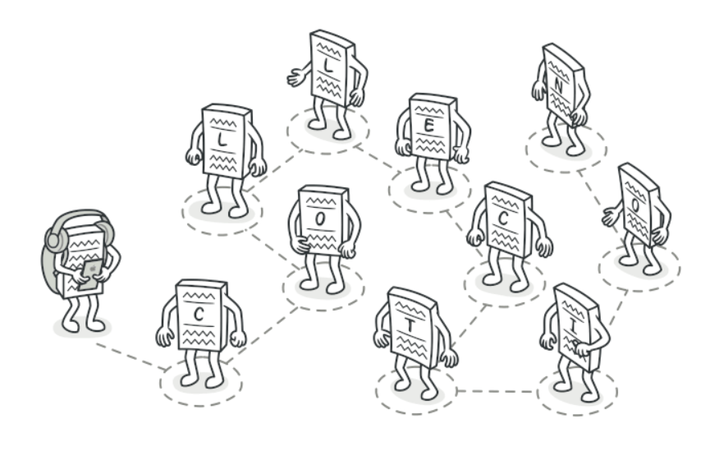
Iterator Pattern
.

Slide 16
Strategy Pattern
A strategy pattern or Policy pattern is a behavioral design pattern that helps us to write a generic code that gives us specific behavior needed for given use cases. It allows us to select both the behavior and the algorithm at runtime, based on the input of the client.
When to use Strategy Pattern
When we have a use case of deciding how the objects will behave dynamically.
When we want to use different variants of an algorithm within an object and be able to switch from one algorithm to another during runtime.

Slide 17

Strategy Pattern
.

Slide 18
Template Pattern
A template pattern is used to define the framework of an algorithm in the superclass and lets the subclasses redefine certain steps of an algorithm without changing the overall algorithm's structure.
When to use Template Pattern
When several classes contain almost identical algorithms, and we need to modify all the classes when there is a change in the algorithm.
When we want to allow the clients to extend only particular steps of an algorithm, but not the whole algorithm or its structure.

Slide 19
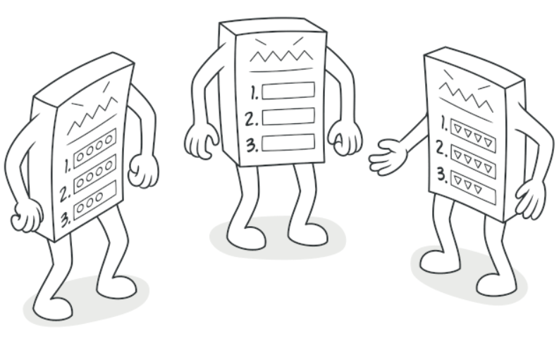
Template Pattern
.

Slide 20
Mediator Pattern
The mediator pattern is used to simplify the communication between multiple objects or classes. It provides a mediator class that handles all the interactions going on between different objects or classes. This pattern also promotes loose coupling by keeping objects from referring to each other explicitly.
When to use Mediator Pattern
When the application consists of such a large number of objects that it becomes difficult to manage their references.
When it is difficult to change some classes because of the presence of tight coupling.

Slide 21
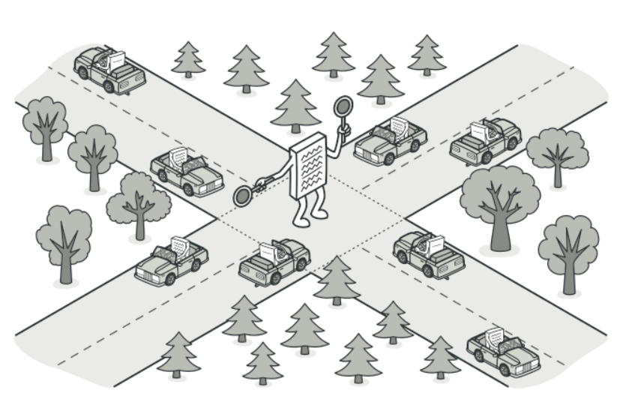
Mediator Pattern
.

Slide 22
Memento Pattern
The memento pattern is used to implement the undo operation i.e., it allows us to save and restore an object to its previous state. It wraps the entire object state in a single object known as the Memento that allows the entire state to be saved and restored in a single action.
When to use Memento Pattern
When we wish to produce the snapshots of the object's state to get the ability to restore the previous states of an object. The snapshot of an object represents its state at a particular instance in time in an object-oriented application.

Slide 23
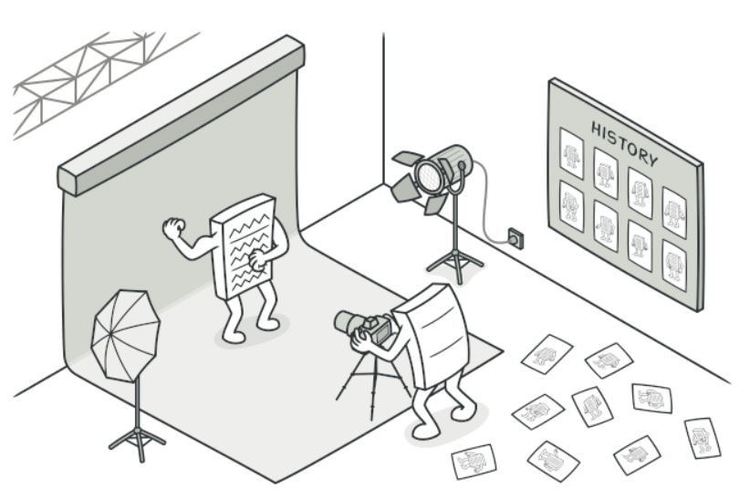
Memento Pattern

Slide 24
Visitor Pattern
The visitor design pattern is used to separate an algorithm from the object structure on which it operates. It allows us to define and add new operations to the existing classes without affecting the existing structure.
When to use Visitor Pattern
When we wish to perform an operation on all the elements of a complex object structure.
When we wish to extend the interface of the primary type by creating a separate class hierarchy.

Slide 25
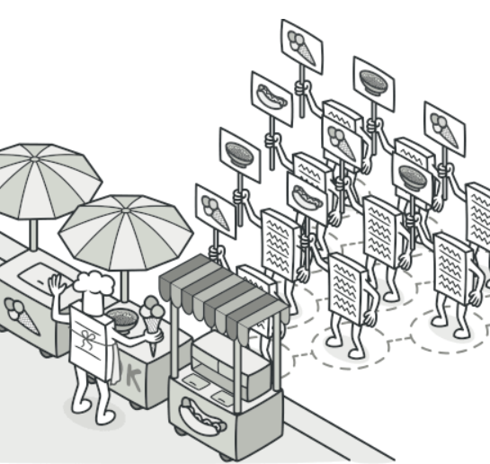
Visitor Pattern
.

Slide 26
What are the Problems Solved by Behavioral Design Patterns?
It reduces the complexity of communication between the objects.
It provides the best object interaction principles of software development.
It reduces the coupling between the senders and the receivers and enables better communication flexibility in the application.
It is used to save the number of resources being used by an application as better object interaction leads to better task execution.

Slide 27
Conclusion
What is a behavioral design pattern?
How each behavioral design pattern differs from one another and the specific use case in which a pattern is applied.
Finally, we have discussed the problems that are solved by behavioral design patterns and why it is efficient in building an object-oriented application.
behavioral design patterns are a powerful tool for managing and organizing the behavior of objects in an application. These patterns provide a common vocabulary for discussing and solving common problems related to object interaction and communication

